Slide 1
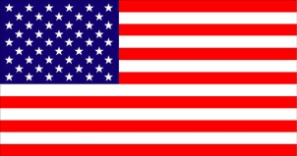
Democracy
The United States government
is a
DEMOCRACY!
Democracy means the rule of the people. In a democracy, everyone’s vote counts. There is no king or queen completely in charge of our country and its decisions. Everyone in a democracy has a say in what should happen!

Slide 2
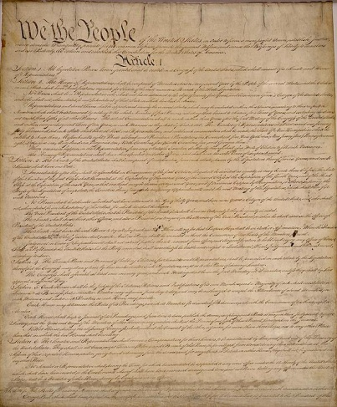
This paper is our country’s
CONSTITUTION

Slide 3
The Constitution of the U.S.
The Constitution has 4 basic parts:
Part 1
Allows government to make LAWS
Part 2
Gives the PRESIDENT the power to make decisions
Part 3
Sets up a SUPREME COURT
Part 4
Talks about the STATES and making CHANGES to the
constitution.

Slide 4
The U.S. Constitution
Since it was created about two hundred years ago, over one hundred countries around the world have used it as a model for their own.

Slide 5
More about our Constitution…
On September 17, 1787, the constitution was signed in Philadelphia, Pennsylvania.
39 people signed the constitution!
Here are some names you might recognize:
1. Benjamin Franklin
2. George Washington
3. James Madison

Slide 6
Why do we have LAWS ?
To keep us safe
To encourage common good
common good means
ideas & things that are
shared & right for all
people in our country!

Slide 7
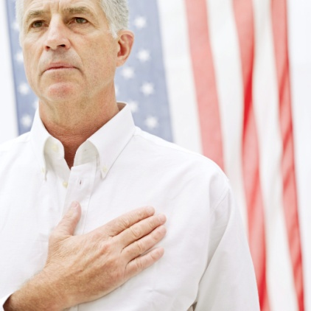
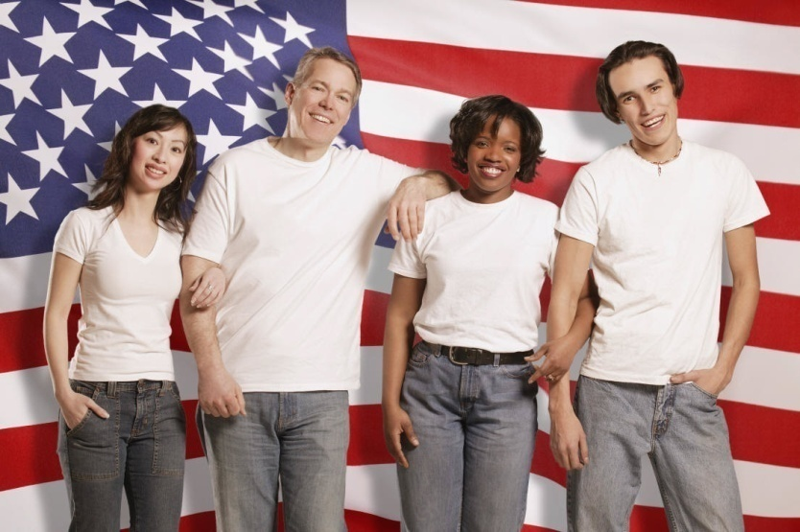
What is a U.S. citizen?
YOU are a United States citizen!
Anyone who legally lives in the U.S. is a citizen!

Slide 8
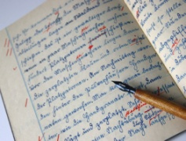
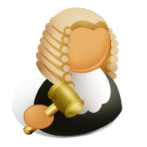
U.S. Citizens have RIGHTS!!
The Right to Vote
The Freedom of Speech
The Freedom of Press
Protection from Harm
Freedom of Religion
Right to a Fair Trial

Slide 9
Citizens have RESPONSIBILITIES too!
Responsibility to Vote
Responsibility to Serve on Jury Duty
Responsibility to Obey the Laws
Responsibility to be Involved with our Government

